Slide 1

B. Tech. Project AY 2024-25
First Presentation (CA-1)
Title of the Project: Text Generation in Gujarati Language
Name of the Guide: Dr. Sheetal Borhade
Name of the Co-guide: Mayur Gaikwad
Group Members:
Darshil Kotecha (21070126051)
Naman Shishangiya (21070126084)

Slide 2
Introduction
Significant progress has been made in the understanding and processing of many languages due to the wide adoption of Natural Language Processing (NLP) techniques. Yet there is a clear lack of models and resources for regional languages such as Gujarati. By creating a BERT model and a NER (Named Entity Recognition) system especially for the Gujarati language, this project seeks to address that problem.

Slide 3
Problem Statement
Whereas there are many models available for commonly used languages such as English, there is a scarcity of robust models for regional languages like Gujarati. This study targets the difficulty of developing an effective BERT model and NER system capable of effectively understanding and processing Gujarati language

Slide 4
Objectives of the Project
To generate word embeddings for the Gujarati language dataset.
To develop a BERT model trained on Gujarati language data.
To create an NER model for the Gujarati language using pre-processed data and advanced NLP techniques.
To optimize the NER model by training it on more data and extending the training epochs.

Slide 5
Project plan with timeline
Data collection and generation of word embeddings.
Development of the BERT model for the Gujarati language.
Pre-processing of data for NER and initial model development.
Training of the NER model and further optimization.
Testing, debugging, and final adjustments to the models.
Documentation and preparation of the final report.

Slide 6
Gap in the Research/ Technology/ Methodology
Despite their success in languages like English, there is a significant research gap concerning the application of BERT and NER models in regional languages like Gujarati. Lack of huge datasets, pre-trained models, and specialized tools hinders the effectiveness of NLP solutions for Gujarati

Slide 7
Description of the proposed solution
This project proposes the development of a BERT model tailored to the Gujarati language by training it on a substantial Gujarati dataset. Additionally, an NER model will be created using data pre-processed for Next Sentence Prediction (NSP) to enhance its accuracy and reliability.

Slide 8
Requirement Analysis
Hardware: High-performance computing resources for model training.
Data: A large, diverse dataset in Gujarati language for training purposes.

Slide 9
Technology Stack:
Programming Language: Python
Libraries Used: TensorFlow, PyTorch, Hugging Face Transformers, NLTK
Platform: Google Colab for model development and training.

Slide 10
Development/ Implementation
The development phase involved generating word embeddings for the Gujarati dataset, followed by creating a BERT model specifically for the language. The NER model development is ongoing, with data pre-processed according to NSP, and the model is being trained on additional data with more epochs to improve its performance.

Slide 11
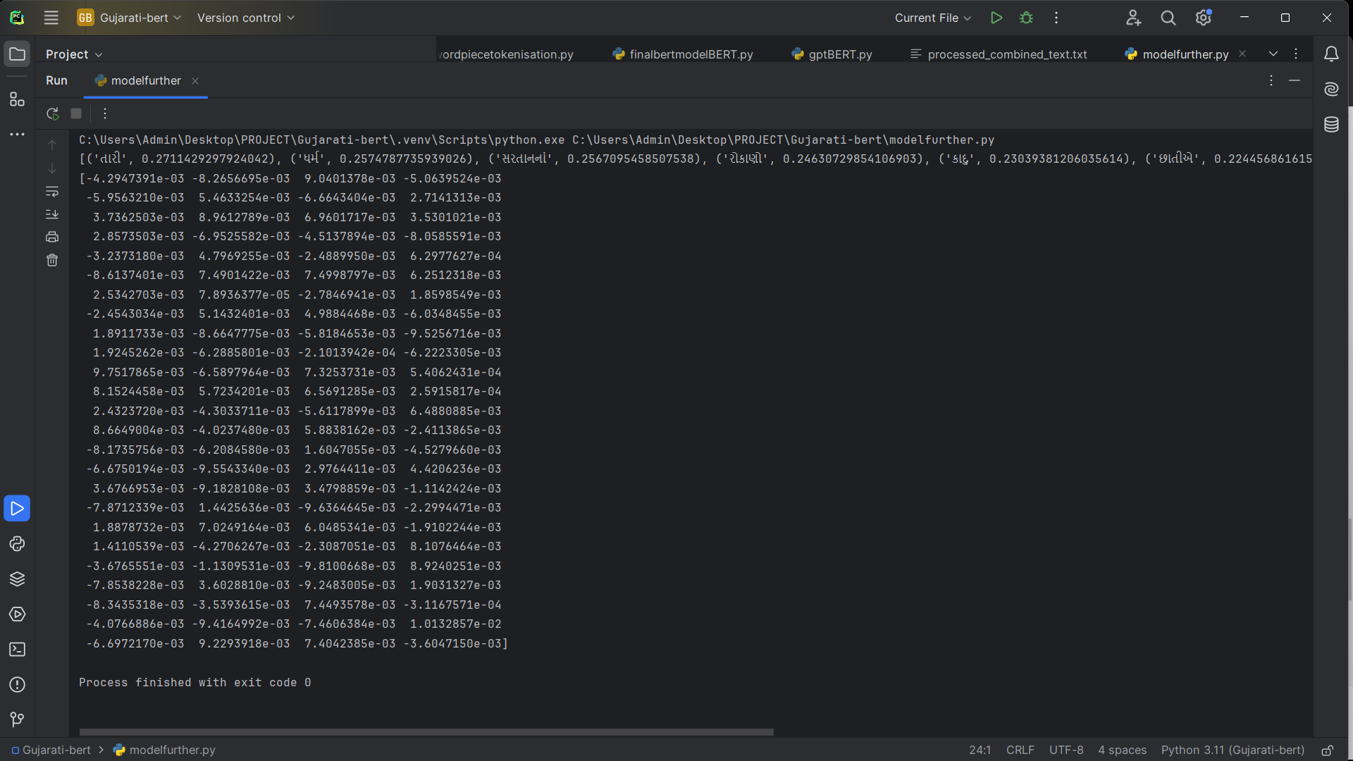
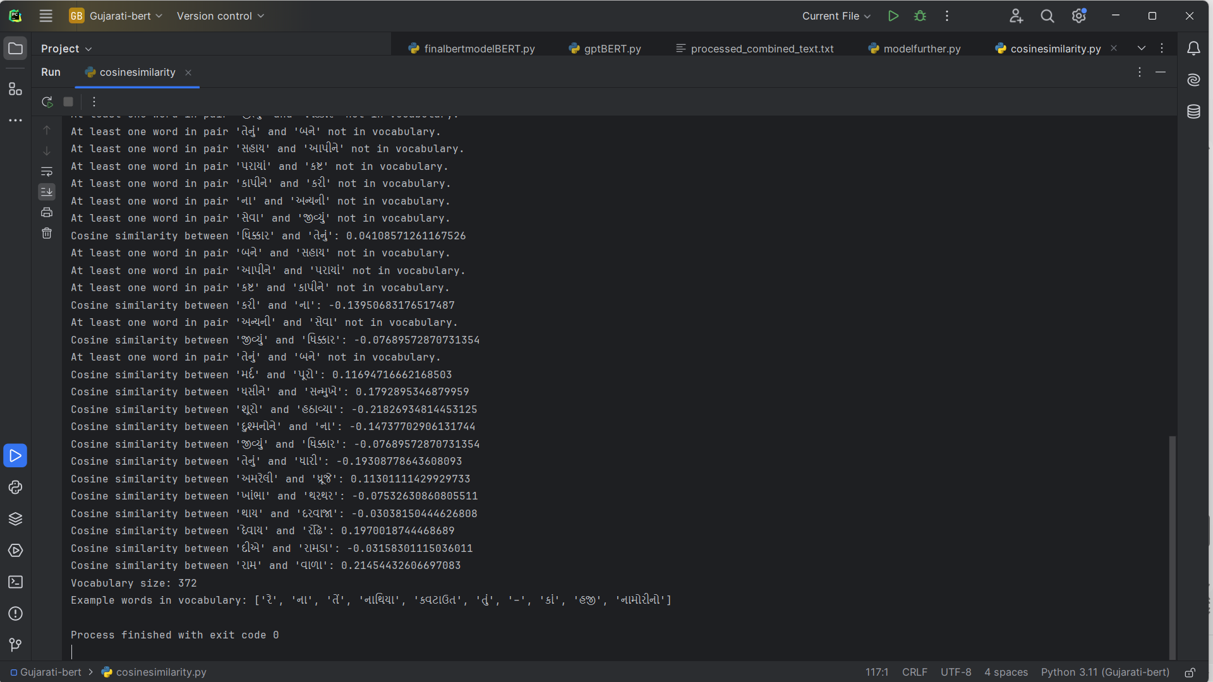
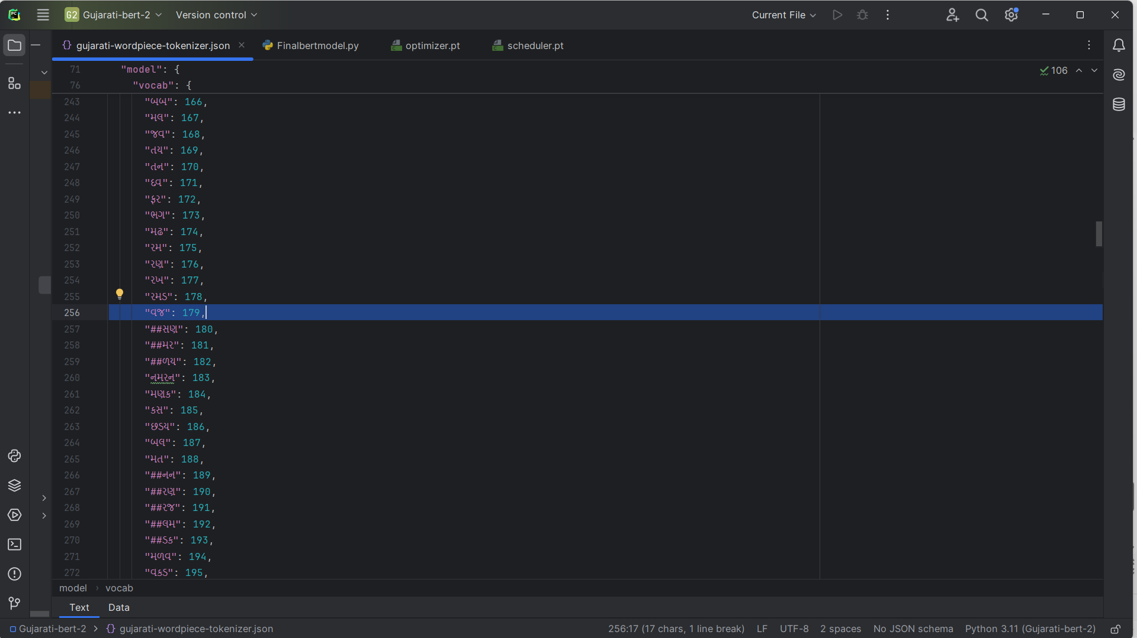
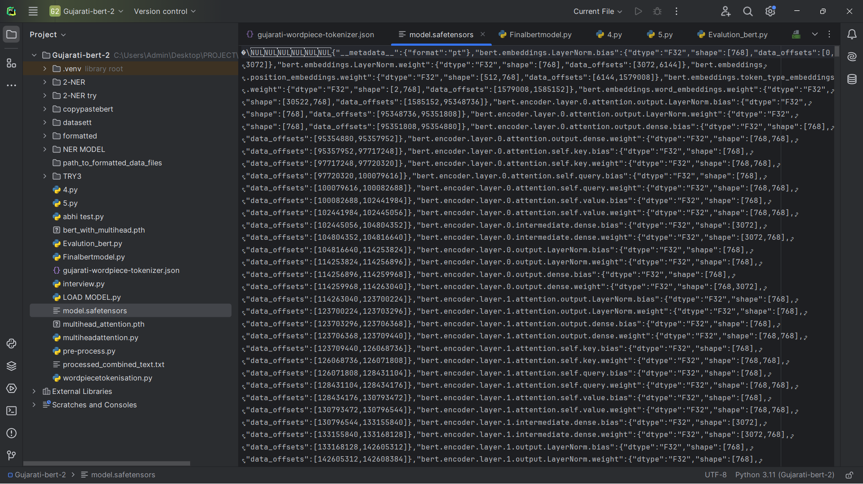
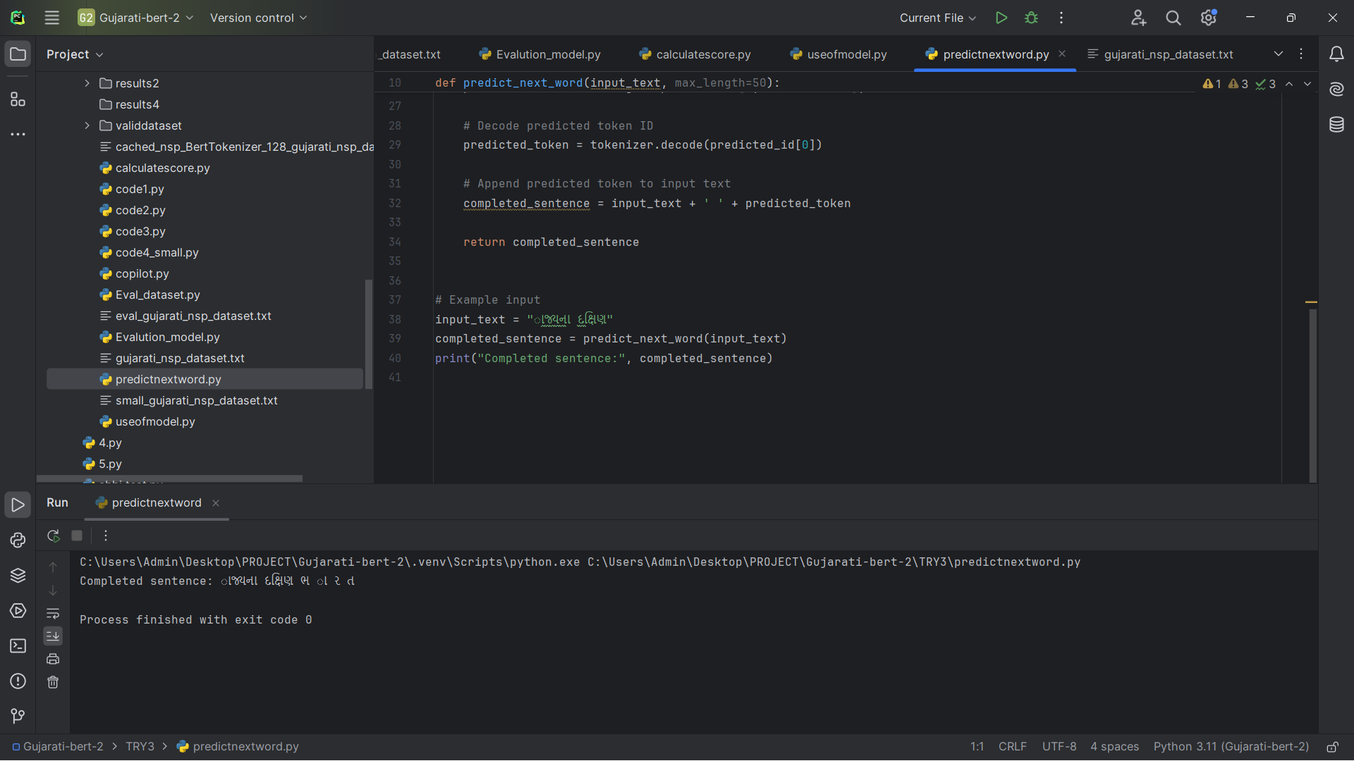
Project Outcome
Word Embedding
Cosine Similarity
Word Tokenisation
BERT Model
NSP Model

Slide 12
Literature Review :
BERT: Pre-training of Deep Bidirectional Transformers for Language Understanding
Authors: Devlin et al.
Year: 2018
Key Focus: Introduces BERT, its Transformer-based architecture, and its applications in NLP tasks
Methodology:
BERT uses a transformer-based architecture with self-attention mechanisms
Pre-trained using masked language modeling (MLM) and next sentence prediction (NSP) tasks on large corpora
2. Multilingual BERT for Named Entity Recognition in Indian Languages
Authors: Shrivastava et al.
Year: 2020
Key Focus: Explores the use of mBERT for NER in Indian language
Methodology:
Used multilingual BERT (mBERT)
Fine-tuned mBERT for NER tasks on Indian language datasets
Evaluated performance using precision, recall, and F1 scores
IndicBERT: A Pretrained Model for Indic Languages
Authors: Kakwani et al.
Year: 2020
Key Focus: Development of IndicBERT, a model pre-trained on 12 major Indian languages
Methodology:
IndicBERT uses a smaller pre-trained BERT model
Fine-tuned on Indian languages
Utilized masked language modeling (MLM) and next sentence prediction (NSP) on Indic text corpora

Slide 13
Literature Review :
4. A Comprehensive Study of Named Entity Recognition in the Hindi Language
Authors: Mishra et al.
Year: 2018
Key Focus: NER techniques in Hindi and insights for low-resource languages like Gujarati
Methodology:
Used BiLSTM-CRF and hybrid approaches combining rule-based and statistical methods
Explored transfer learning from high-resource to low-resource languages
5. NLP for Low Resource Indian Languages: A Survey
Authors: Gupta et al.
Year: 2021
Key Focus: Survey of NLP advancements in low-resource Indian languages
Methodology:
Reviewed methodologies like supervised learning, semi-supervised learning, and transfer learning
Highlighted the importance of labeled datasets and pre-trained models for low-resource languages
6. Towards Gujarati Language Understanding: Developing BERT for Gujarati
Authors: Kulkarni et al.
Year: 2021
Key Focus: Development of a Gujarati BERT model using local datasets
Methodology:
Fine-tuned BERT on a corpus of Gujarati text
Used masked language modeling (MLM) for pre-training on domain-specific Gujarati datasets
7. A Deep Learning Approach for Named Entity Recognition in Sanskrit
Authors: Patil et al.
Year: 2019
Key Focus: Deep learning NER models applied to low-resource languages like Sanskrit
Methodology:
Used BiLSTM with CRF layers for NER
Experimented with word embeddings generated from Sanskrit corpora
Used a character-level CNN for better word representation

Slide 14
Conclusion:
This study shows the possibility and usefulness of developing advanced NLP models like as BERT and NER for regional languages. By focusing on Gujarati, this research adds important assets and insights to the area of NLP, perhaps supporting future development in other regional languages as well

